Slide 1
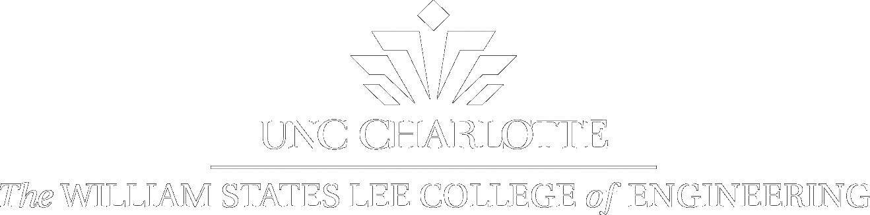
August 2017 Research Review

Slide 2
Membrane Experiment Summary
Purpose:
Create a tunable acoustic absorber based on metamaterials.
One possibility is a membrane-based system (e.g. Yang & Sheng)
Membrane stretched over a grid
“Decorated” with masses to engineer freuqncy
Approach:
Use a drum head as the membrane and design an appropriate grid
Types of Membranes (drum heads) used:
Mesh
Solid
Grid was designed Stokes research group for 3 resonator frequencies, which were designed to be shifted in the frequency spectrum due to tension of the membrane.

Slide 3
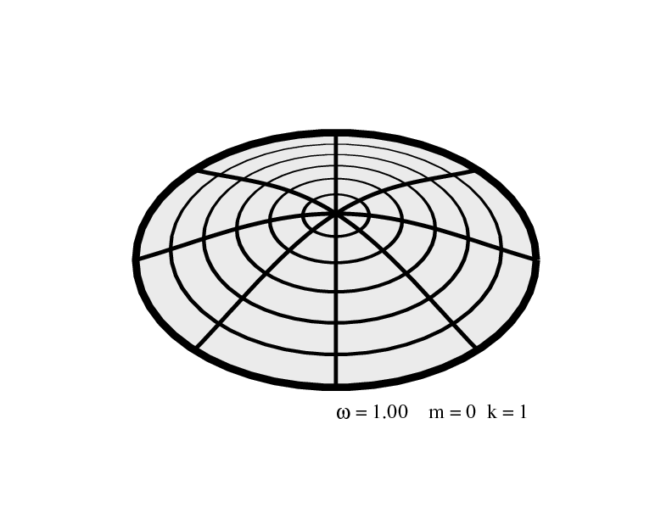
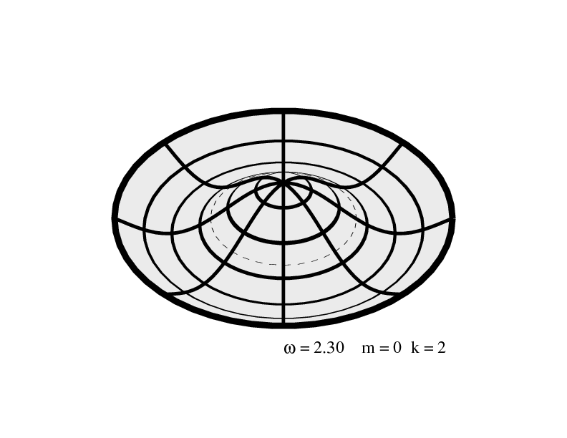
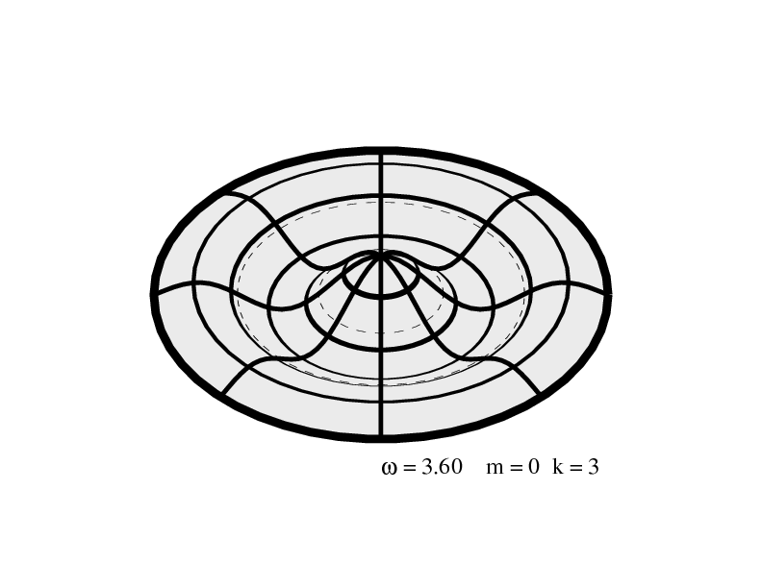
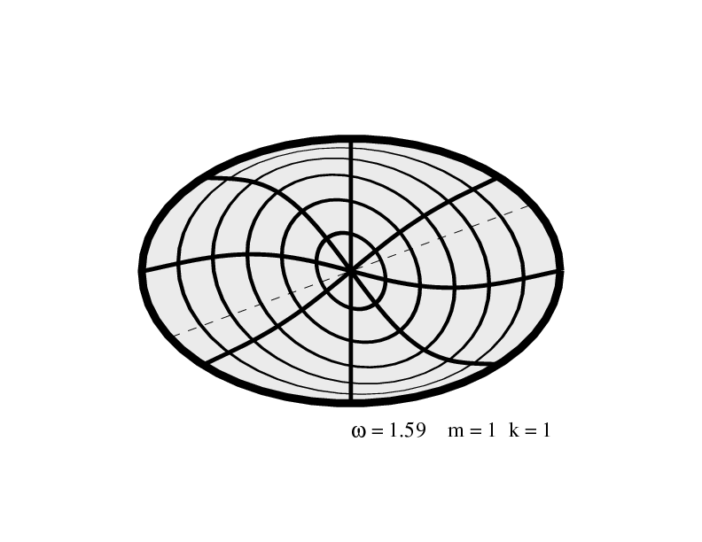
Vibrational Modes of a Circular Membrane
Labeling of Modes:
(d , c)
d = number of nodal diameters
c = number of nodal circles
Node: is a point on the structure that does not move while the rest
of the structure is vibrating
(0,1)
(0,2)
(1,1)
(0,3)

Slide 4
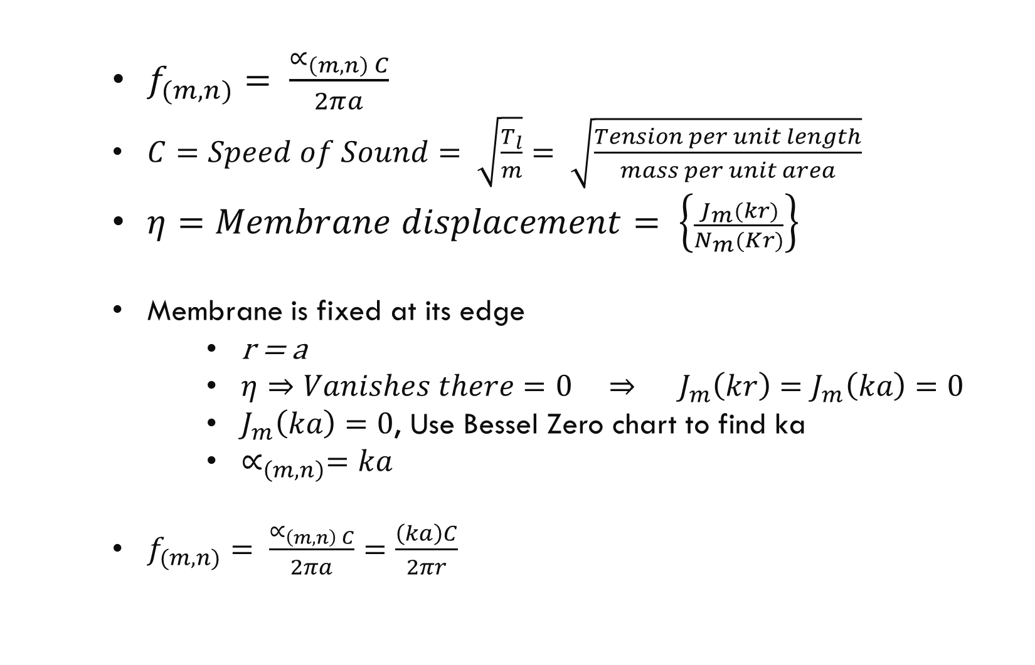
Vibrational Modes of a Circular Membrane
Natural Frequency of Circular Membrane:
$f_{(m,n)}= \frac{∝_{\left(m,n\right) C}}{2πa}$
$C=Speed of Sound= \sqrt{\frac{T_{l}}{m}}= \sqrt{\frac{Tension per unit length}{mass per unit area}}$
$η=Membrane displacement= \left\{\frac{J_{m}(kr)}{N_{m}(Kr)}\right\}$
Boundary Conditions:
Membrane is fixed at its edge
r = a
$η⇒Vanishes there=0 ⇒ J_{m}\left(kr\right)=J_{m}\left(ka\right)=0$
$J_{m}\left(ka\right)=0$, Use Bessel Zero chart to find ka
$∝_{\left(m,n\right)}=ka$
$f_{(m,n)}= \frac{∝_{\left(m,n\right) C}}{2πa}=\frac{\left(ka\right)C}{2πr}$

Slide 5
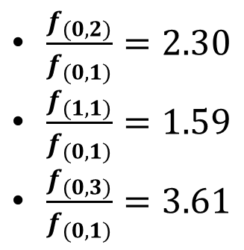

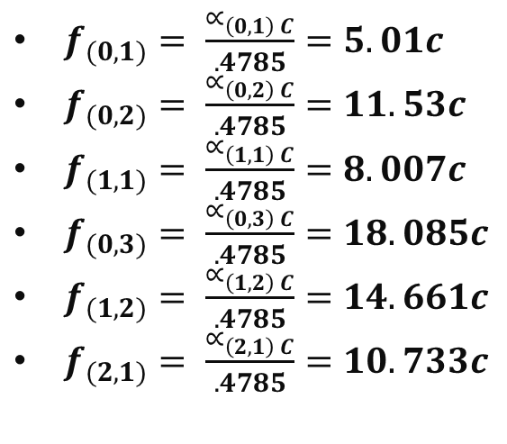
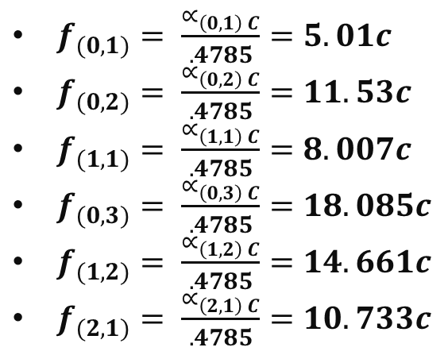

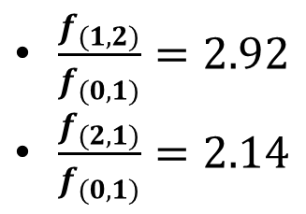
Circular Membrane
$f_{(m,n)}= \frac{∝_{\left(m,n\right) C}}{2πa}= \frac{∝_{\left(m,n\right) C}}{.4785}$
$2πa=2πr=2π\left(.0762 m\right)≈ .4785 m$
$∝_{\left(0,1\right)} ≈2.4048$
$∝_{\left(0,2\right)} ≈5.5201$
$∝_{\left(1,1\right)} ≈3.8317$
$∝_{\left(0,3\right)} ≈8.6537$
$∝_{\left(1,2\right)} ≈7.0156$
$∝_{\left(2,1\right)} ≈5.1356$
$f_{(0,1)}= \frac{∝_{\left(0,1\right) C}}{.4785}=5.01c$
$f_{(0,2)}= \frac{∝_{\left(0,2\right) C}}{.4785}=11.53c$
$f_{(1,1)}= \frac{∝_{\left(1,1\right) C}}{.4785}=8.007c$
$f_{(0,3)}= \frac{∝_{\left(0,3\right) C}}{.4785}=18.085c$
$f_{(1,2)}= \frac{∝_{\left(1,2\right) C}}{.4785}=14.661c$
$f_{(2,1)}= \frac{∝_{\left(2,1\right) C}}{.4785}=10.733c$
$f_{(0,1)}= \frac{∝_{\left(0,1\right) C}}{.4785}=5.01c$
$f_{(0,2)}= \frac{∝_{\left(0,2\right) C}}{.4785}=11.53c$
$f_{(1,1)}= \frac{∝_{\left(1,1\right) C}}{.4785}=8.007c$
$f_{(0,3)}= \frac{∝_{\left(0,3\right) C}}{.4785}=18.085c$
$f_{(1,2)}= \frac{∝_{\left(1,2\right) C}}{.4785}=14.661c$
$f_{(2,1)}= \frac{∝_{\left(2,1\right) C}}{.4785}=10.733c$
Ratio of the Natural Frequency of a mode to the Natural Frequency of the fundamental mode (0,1)
$\frac{f_{(0,2)}}{f_{(0,1)}}=2.30$
$\frac{f_{(1,1)}}{f_{(0,1)}}=1.59$
$\frac{f_{(0,3)}}{f_{(0,1)}}=3.61$
$\frac{f_{(1,2)}}{f_{(0,1)}}=2.92$
$\frac{f_{(2,1)}}{f_{(0,1)}}=2.14$

Slide 6
Circular Membrane Expected Results
What do we expect to see in the results with just drumhead?
According to the previous slides, the only thing that changes is the
tension, which means as the tension increases, the resonant frequencies
should shift right (higher frequencies)

Slide 7
Experimental setup
Drawings
Circles & arrows etc.
Picture of mesh membrane
Picture of solid membrane
Table of experiments so far
Mesh with and without grid?
Solid with and without grid?
“green grid” vs “gray grid”

Slide 8
Mesh Circular Membrane – no grid – why not subtract baseline?
Results from the August 15 Trial, with the Mesh Membrane. As can observed with
each turn that the frequency is not shifting, which is consistent with previous
Trials where we observed no shifting and/or incorrect shifting.
Blow this up; Do these peaks shift to higher frequency?

Slide 9
Solid Circular Membrane – no grid – baseline subtracted
Due to the Solid Membrane absorbing any frequency a little above 10kHz, all other trials are
from 50Hz to 10kHz. The trial from August 11 was from 50 Hz to 11kHz. Also, we concluded as
we have seen in other trials that at 1 Turn, that each screw may not apply enough or uniform
tension on membrane. Thus, for now are focus is data for Turns 1 and 2. The data shown below
has been normalized.
Table of peaks and how they shift and how they compare to theory

Slide 10
Solid Circular Membrane
Continued August 11 trial Results
It can be observed in the results shown above that the solid membrane’s absorption peak frequencies are
generally shifting to the right with tension. This means that the solid drum head is acting as one membrane.
Thus, we can use it in other experiments. Our next step was to include the grid
Should we also be measuring phase?
http://www.swarthmore.edu/NatSci/echeeve1/Ref/U8903A/U8903A_Bode.html

Slide 11
Grid and Membrane
We expect the cells of the grid to force the Membrane to act independently
of other parts of the membrane. If this occurs, we no longer have 1 circular
membrane but many rectangular membranes.

Slide 12
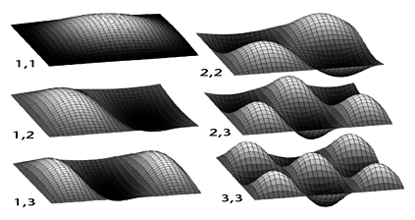
Vibrational Modes of a Rectangular Membrane
Labeling of Modes:
(m , n)
m = number of nodal diameters
n = number of nodal circles
Node: is a point on the structure that does not move while the rest
of the structure is vibrating

Slide 13
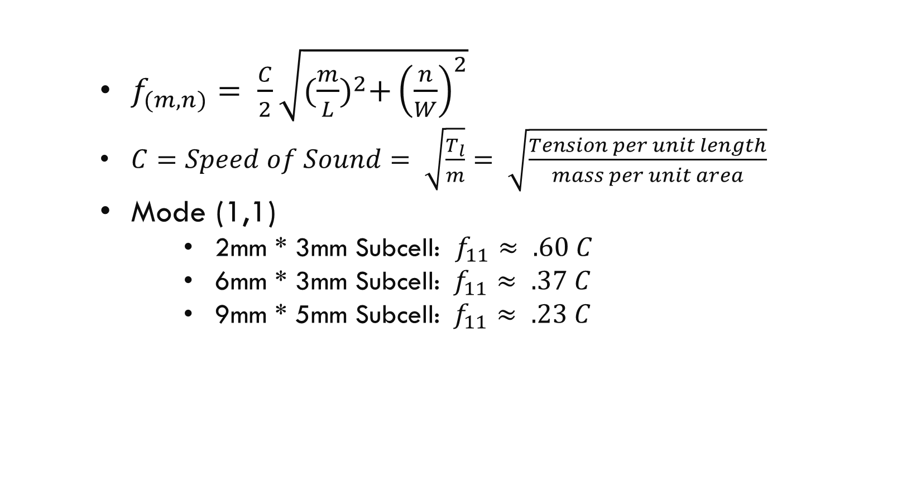
Vibrational Modes of a Rectangular Membrane
Natural Frequency of Rectangular Membrane:
$f_{(m,n)}= \frac{C}{2}\sqrt{{(\frac{m}{L})}^{2}+{\left(\frac{n}{W}\right)}^{2}}$
$C=Speed of Sound= \sqrt{\frac{T_{l}}{m}}= \sqrt{\frac{Tension per unit length}{mass per unit area}}$
Mode (1,1)
2mm * 3mm Subcell: $f_{11}≈ .60 C$
6mm * 3mm Subcell: $f_{11}≈ .37 C$
9mm * 5mm Subcell: $f_{11}≈ .23 C$

Slide 14
Solid Circular Membrane With Green Grid – subtract?

Slide 15
Solid Circular Membrane With Green Grid - subtract
Results from the trial on August 25
We could not finish the trial because we couldn’t tighten the drum
head.

Slide 16
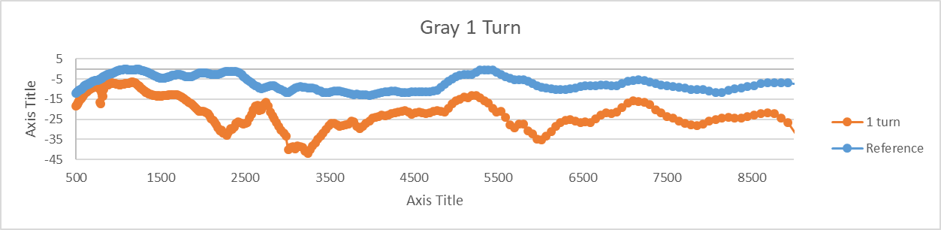
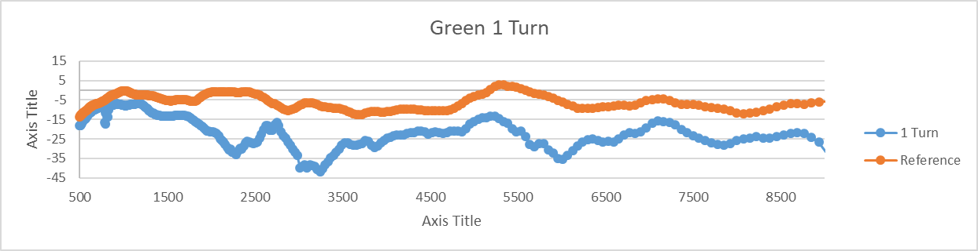
Solid Circular Membrane With Gray Grid
Results from the trial on August 27
We could not finish the trial because the Gray Grid broke. At one turn the Gray
grid’s response is nearly the same as the Green grid’s response at 1 turn

Slide 17
Thoughts
Are we getting major Absorption due to just shifting of the resonant frequencies?
Probably Not

Slide 18
Thoughts
Are we getting major Absorption due to just shifting of the
absorption frequencies of the Solid membrane?

Slide 19

Future Plans for Solid Membrane
1.) Find another material for the membrane that is solid, since the current
solid membrane has no give.
Possible replacements:
Rubber
Animal Hide
Other Plastic materials
Matias thoughts
2.) We need to lower the frequencies to filter out the 800 Hz of the Fan.
We can lower it by changing the properties of the membrane to
change C. $C=Speed of Sound= \sqrt{\frac{T_{l}}{m}}$
T goes down, f goes down
M goes up, f goes down
3.) Redesign Grid Accordingly and Reprint the Grid

Slide 20
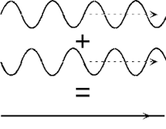
New Approach (Coherent Perfect Absorption)
Introduce a counterpropagating wave to the input wave this should create
destructive interference as seen below.
How to produce the counterpropagating wave?
Helmholtz resonators

Slide 21
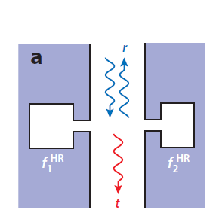
New Approach (Helmholtz Resonators)
How are the Helmholtz Resonators going to sit in a channel?
We want two Helmholtz resonators across from each other, because they become coupled, if the
channel is smaller than the wavelength.
We have three Resonance due to the Helmholtz Resonators.
F1HR = Resonance Frequency of Helmholtz Resonator on the Left.
F2HR = Resonance Frequency of Helmholtz Resonator on the Right
Hybrid Resonance Frequency
Hybrid Resonance Frequency = (F2HR – F1HR)/2

Slide 22
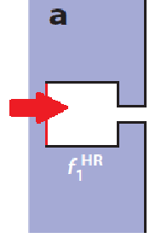
New Approach
Can we make this tunable?
Yes, we can make the back wall of the Helmholtz Resonator adjustable
as seen in the picture below.

Slide 23

New Approach
How many do we place Along the Channel?
From setup of paper we pulled from.
Possible advantages:
We can target multiple bands of frequencies to filter.

Slide 24
New Approach
What are the dimensions of the channel and the Helmholtz Resonators?
Helmholtz Resonators:
The dimensions of the Helmholtz Resonator depend on which
frequencies we want to filter.
Channel:

Slide 25
New Approach
Proposed Plan for New Approach
1.) Create a channel with one Helmholtz Resonator. (Let’s get the basics working)
A. Determine all the dimensions based on theory for Helmholtz Resonators. And used the
Fan Frequencies we want to filter
B. Create a Model in Comsol
C. Create the real Model
D. Test
2.) Create a channel with multiple Helmholtz Resonator on one side
3.) Create a channel with two Helmholtz Resonator, with one on either side.
4.) Depending on the results 2.), do the same as 2 for both sides.

Slide 26
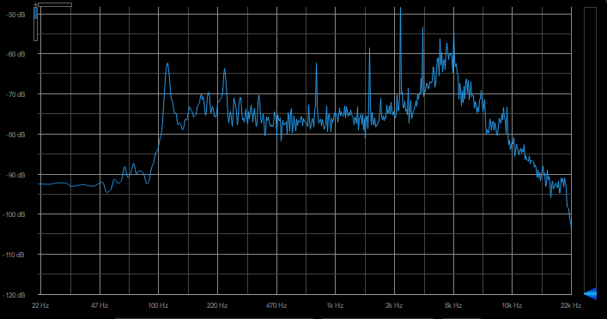
Fan Noise Spectrum
Below we have the spectrum of the Fan Noise at 12V, which is the max voltage.
Notable Frequencies:
802 Hz, 1616 Hz, 2400Hz, 3189 Hz
These are harmonics of frequencies

Slide 27
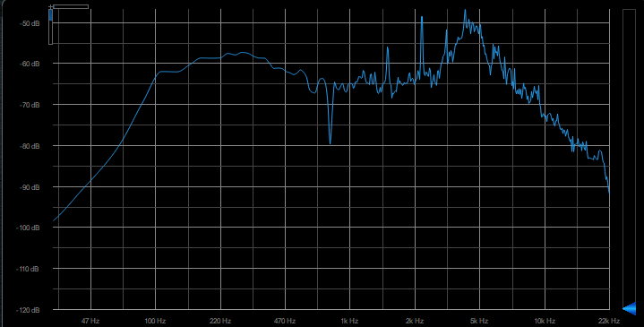
Fan Noise Spectrum
After applying a filter at 800 Hz, 2400 Hz, and 3189 Hz
800 Hz Filtered

Slide 28
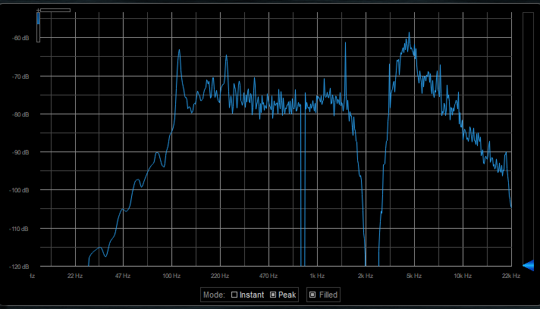
Fan Noise Spectrum
After applying a filter at 800 Hz, 2400 Hz, and 3189 Hz
800 and 2400 Hz Filtered

Slide 29
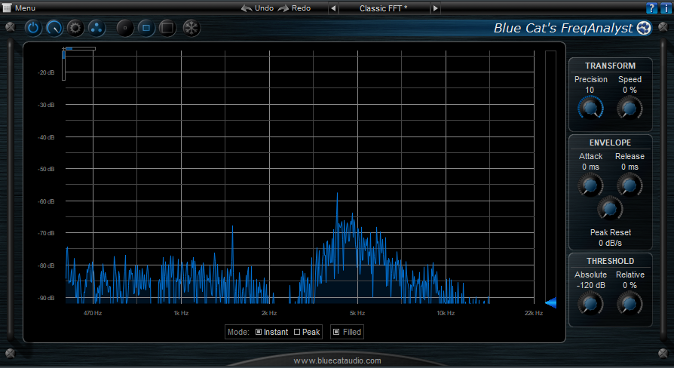
Fan Noise Spectrum
After applying a filter at 800 Hz, 2400 Hz, and 3189 Hz
800 and 2400 and 3189 Hz Filtered

Slide 30

Fan Noise Spectrum
Listen to the difference
No Filter
All Filters

